Slide 1
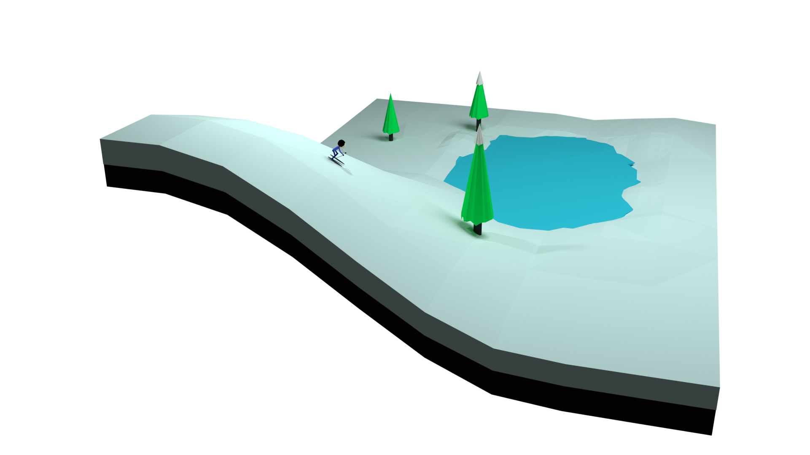


Nuclear DOF
Derivative Coupling
A Trajectory gonna Blow up
Arkajit Mandal
Advisor: Pengfei Huo
University of Rochester
QUASI-DIABATIC REPRESENTATION for NONADIABATIC DYNAMICS

Slide 2

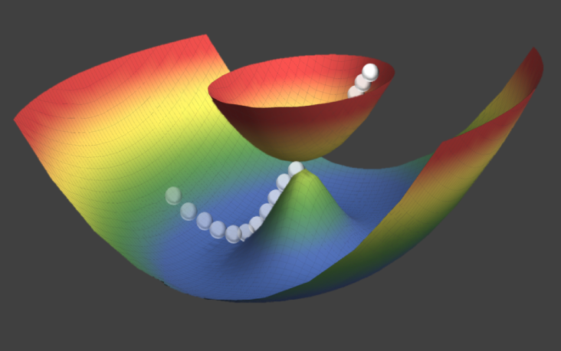
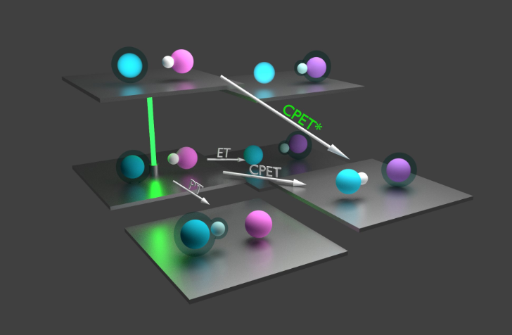
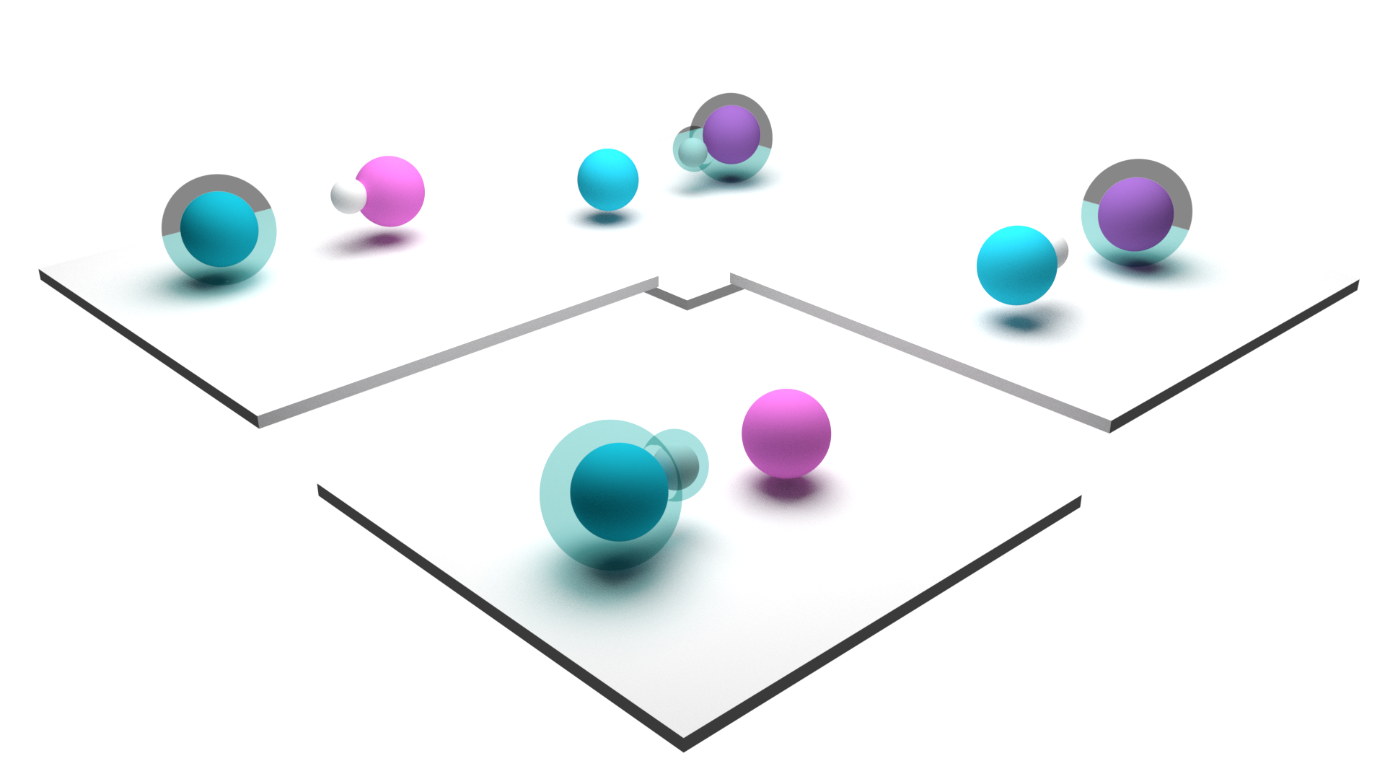
Contents
Application to Thermal PCET
Development of
Quasi Diabatic Scheme
Application to PI-PCET

Slide 3

Contents
Development of
Quasi Diabatic Scheme

Slide 4

Molecular Hamiltonian

Slide 5
Molecular Hamiltonian
Kinetic Energy Operator of nuclear Degrees of Freedom
Potential Energy Operator of all Degrees of Freedom
Kinetic Energy Operator of electronic Degrees of Freedom

Slide 6
Molecular Hamiltonian
Electronic Hamiltonian

Slide 7
1. Painfully Exact

Slide 8
Non-Adiabatic Dynamics

Slide 9
Non-Adiabatic Dynamics
Nonadiabatic
Molecular Dynamics
Molecular Dynamics

Slide 10
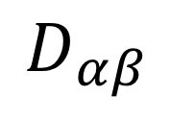
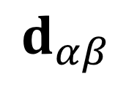
Adiabatic Representation
=
$$d_{αβ}$$
= ∞
$$D_{αβ}$$
0 =

Slide 11

Adiabatic and Diabatic Representation
$$\left|j\right\rangle =\sum_{α}{C_{jα}}|E_{α}(R)⟩$$
Diabatic
state
It is simpler to run dynamics in Diabatic Representation
It is simpler to obtain Adiabatic State

Slide 12
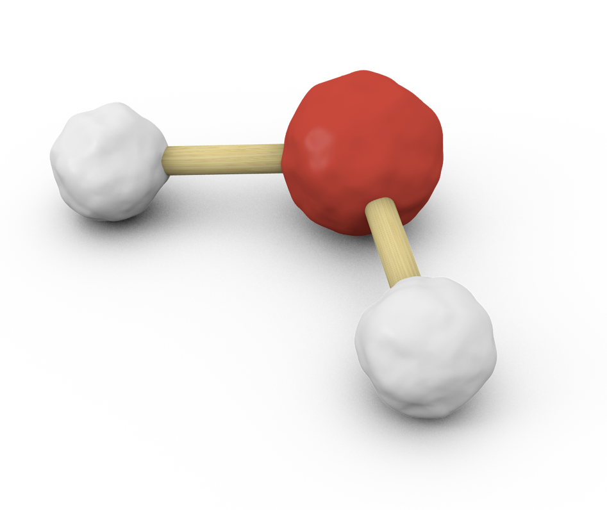
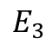
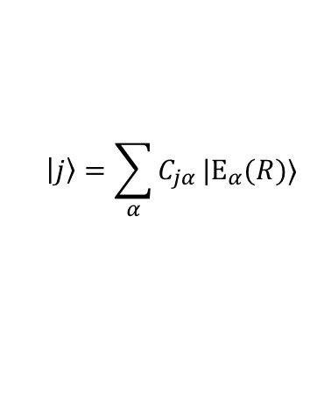
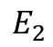

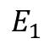
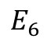

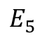
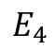
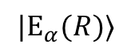
Nonadiabatic Dynamics in various Representation
Electronic Structure
Calculation
$$E_{6}$$
$$E_{5}$$
$$E_{4}$$
$$→$$
$$E_{3}$$
$$E_{2}$$
$$E_{1}$$
$$→$$
DIABATIZATION
$$|E_{α}(R)⟩$$
$$\left|j\right\rangle =\sum_{α}{C_{jα}}|E_{α}(R)⟩$$
Nonadiabatic Simulation in
Diabatic Representation
Nonadiabatic Simulation in
Adiabatic Representation
Example : PLDM, SQC
Example : Surface Hopping
REFORMULATION in
ADIABATIC REPRESENTATION
Example : KM-SQC

Slide 13

Surface Hopping Vs Ehrenfest
Time (ps)
Nonadiabatic Simulation in
Diabatic Representation
Nonadiabatic Simulation in
Adiabatic Representation
Example : PLDM, SQC
Example : Surface Hopping
Tao et al. JPCL, 2010, 1 (6) 891
Kelly et al. JPCL, 2011, 2 (7), 808
Notes:
So we have various methods in various representations, all of them have their pros and cons,
But when it comes to On-the-fly simulations we can only use adiabatic based methods

Slide 14
When it comes to on-the-fly simulations diabatic methods in their current form cannot be used.
Nonadiabatic Simulation in
Diabatic Representation
Nonadiabatic Simulation in
Adiabatic Representation
Example : PLDM, SQC
Example : Surface Hopping
1. Problem with diabatic methods

Slide 15

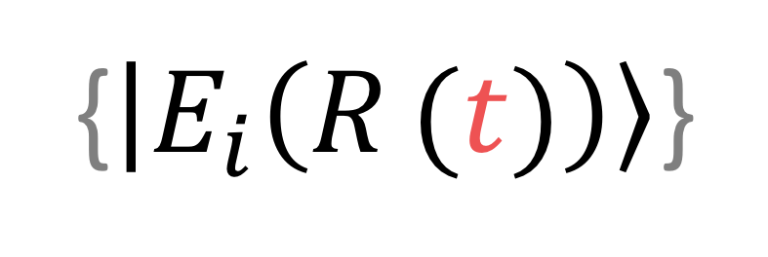
Crude Adiabats
{$\left|E_{i}\left(R_{ }(t)\right)\right\rangle$}
$$≡\{\left|E_{i}\left(R_{0}\right)\right\rangle \}$$
Adiabatic Basis at a reference geometry
is a diabatic basis

Slide 16
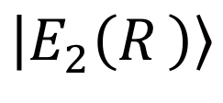
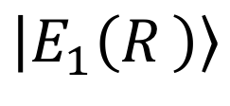


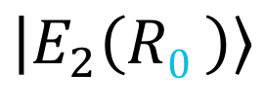
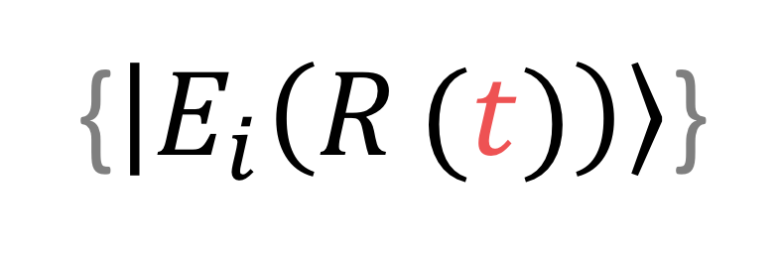

Crude Adiabats
{$\left|E_{i}\left(R_{ }(t)\right)\right\rangle$}
$$≡\{\left|E_{i}\left(R_{0}\right)\right\rangle \}$$
Crude Adiabatic basis is a usable basis only if the molecular geometry is close to the reference geometry
$$\left[\begin{matrix}\begin{aligned}? \\ \end{aligned} \\ ?\end{matrix}\right]$$
$$\left|E_{1}\left({R0}_{ }\right)\right\rangle$$
$$\left|E_{1}\left(R_{ }\right)\right\rangle$$
longtime
Quasi Diabatic basis = Changing crude adiabatic basis
$$\left|E_{2}\left({R0}_{ }\right)\right\rangle$$
$$\left|E_{2}\left(R_{ }\right)\right\rangle$$

Slide 17
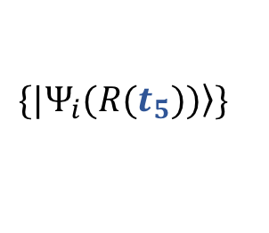

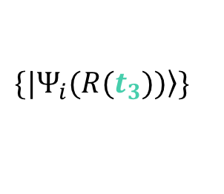
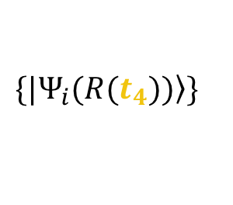
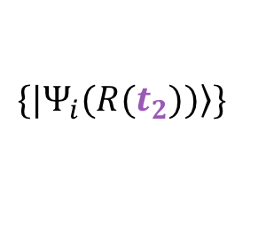


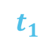
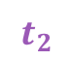
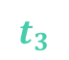
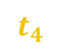

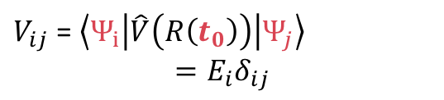
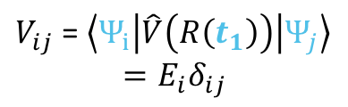
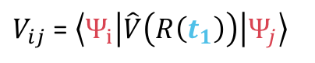
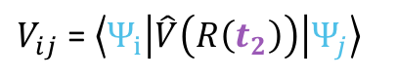
R
t
Use adiabatic basis as quasi Diabatic basis
Dynamically update the basis

Slide 18
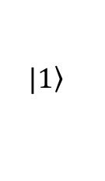

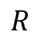
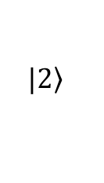
$$\left.|2\right\rangle$$
$$E$$
$$\left.|1\right\rangle$$
$$R$$
1. Diabats

Slide 19

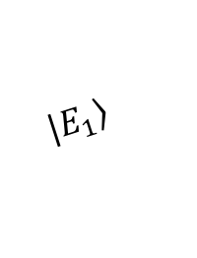
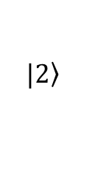

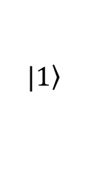
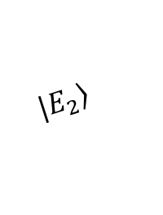
$$\left.|E_{2}\right\rangle$$
$$\left.|2\right\rangle$$
$$E$$
$$\left.|E_{1}\right\rangle$$
$$\left.|1\right\rangle$$
$$R$$
$$E$$

Slide 20
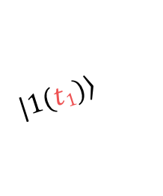
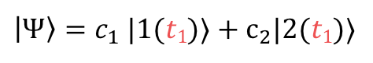
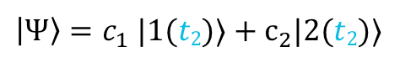

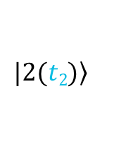


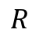


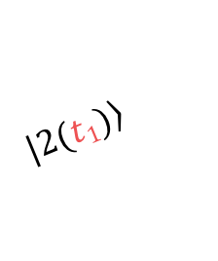

Quasi Diabatic Scheme
$$\left.|E_{2}\right\rangle$$
$$≡$$
$$\left.|2(t2)\right\rangle$$
$$≡$$
$\left|Ψ\right\rangle =c_{1}$ |1(𝑡₂)⟩ + $c_{2}$|2(𝑡₂)⟩
$$\left.|2(t1)\right\rangle$$
$\left|Ψ\right\rangle =c_{1}$ |1(𝑡₁)⟩ + $c_{2}$|2(𝑡₁)⟩
$$≡$$
$$\left.|1(t1)\right\rangle$$
$$\left.|E_{1}\right\rangle$$
$$≡$$
$$E$$
$$\left.|1(t2)\right\rangle$$
$$R$$

Slide 21
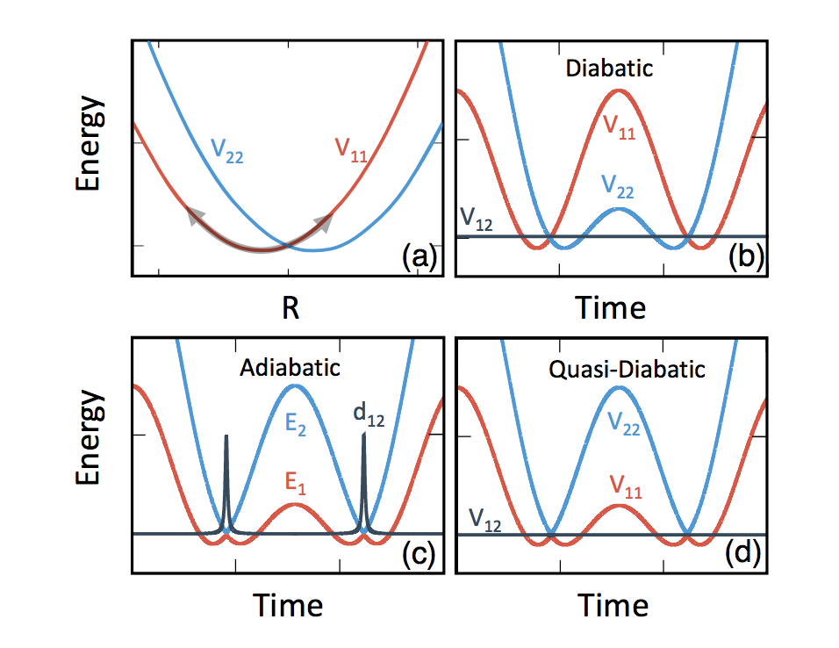


Quasi Diabatic Scheme Summery
 | Availability of on-the-fly PES | Convenience of Dynamics
Adiabatic
Diabatic
Quasi Diabatic
A. Mandal, S. S. Yamijala and P. Huo JCTC 14, 1828 (2018)
J. S. Sandoval, A. Mandal and P. Huo (submitted) (2018)

Slide 22
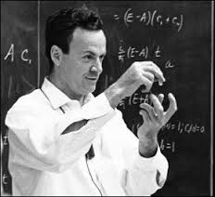

PLDM: A diabatic method
Position
Consistent theoretical framework to treat
both quantum and classical dynamics
Feynman, Rev. Modern Physics (1948)
time
R.P.Feynman
Mapping Representation
Partial Linearization Approximation
Accurate for electronic D.O.F.
reduce computational costs
Consistent footing for electronic and nuclear D.O.F.
Meyer, Miller JCP (1979); Stock, Thoss PRL (1997).
Huo, Coker JCP (2011); Lee, Huo, Coker ARPC (2016)

Slide 23
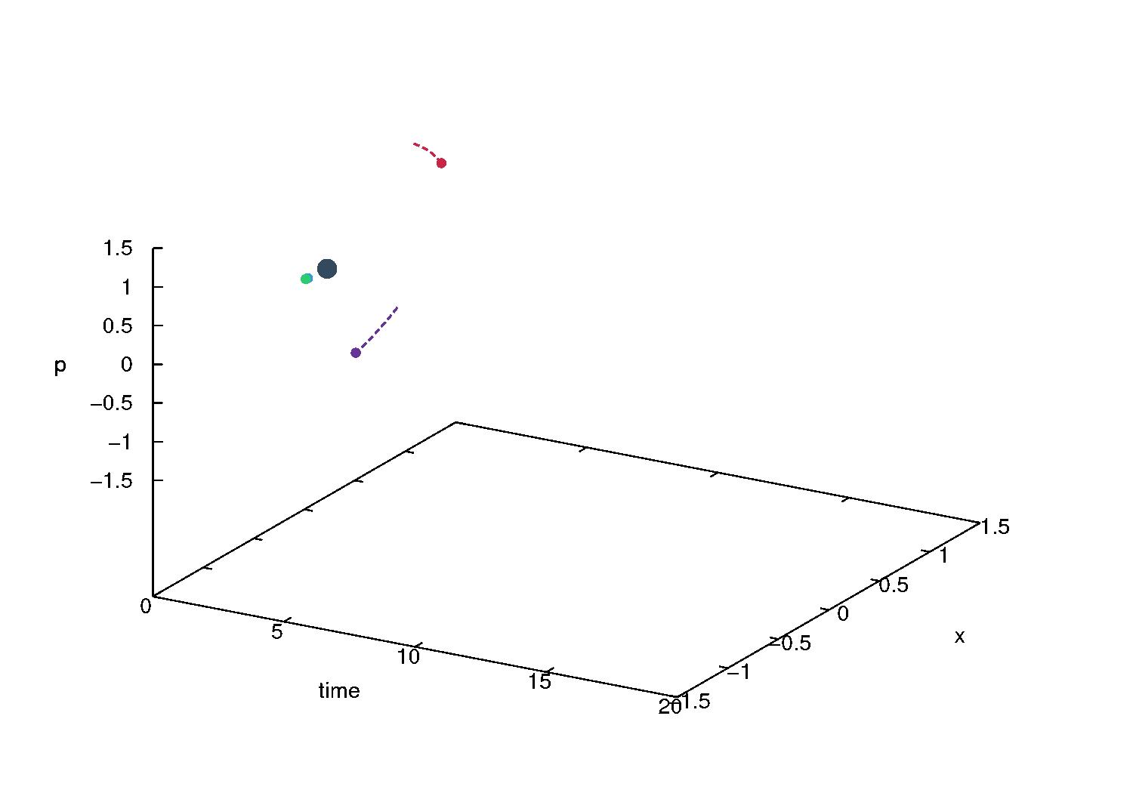
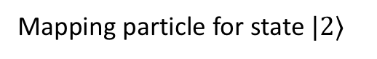
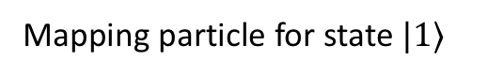
PLDM: A diabatic method
Nuclear Particle
Mapping particle for state $|1⟩$
Mapping particle for state $|2⟩$
Energy
X
PLDM simulation of 2 State 1D Spin Boson with 1 DOF

Slide 24


Things needed to do a non-adiabatic simulation with QD
I need
I don’t need
$$E_{i}$$
$$\left\langle ψ_{i}\right| ∇H | ψ_{j}⟩$$
$\left\langle ψ_{i} (t_{1})\right| ψ_{j} (t_{2})⟩$
$$d_{ij}$$
$D_{ij}$ $\left\langle ψ_{i} (t_{1})\right|\frac{d}{dt}|ψ_{j} (t_{2})⟩$

Slide 25











$$|1⟩$$
$$|2⟩$$
R
q
QD-PLDM algorithm
Step 1 : Initialize
mapping variable
Initialize R(t₁) and P(t₁+Δt/2)
$$(q_{α}, p_{α})→e^{−\frac{1}{2}(q_{α}^{2}+p_{α}^{2}) }$$
$$q_{α}=δ_{αi},p_{α}=δ_{αi}$$
$$q_{β}^{′}=δ_{βi},p_{β}^{′}={−δ}_{βi}$$
Wigner Distribution
$$\left(q_{α}^{′}, p_{α}^{′}\right)→ e^{−\frac{1}{2}(q_{α}^{′2}+p_{α}^{′2}) }$$
or
Sampling
Focused
Step 2 : Electronic Structure Calculation
Obtain QD basis : $\left| Ψ \left(R_{0}\right)\right\rangle =\left| Ψ \left(R_{ }(t_{1})\right)\right\rangle$
Step 3 : Update position
$$R\left(t_{2}\right)=R\left(t_{1}\right)+P\left(t_{1}+\frac{Δt}{2}\right) Δt/M$$
and Obtain $\left| Ψ \left(R_{ }(t_{2})\right)\right\rangle$
Step 4 : Compute Element
$$\left\langle Ψ_{i}\left(R_{0}\right)\right|V\left(t_{2}\right) \left| Ψ_{j} \left(R_{0}\right)\right\rangle =\sum_{i^{′} }{\left\langle Ψ_{i}\left(R_{0}\right)\right|Ψ_{i^{′}}\left(R_{ }(t_{2})\right)⟩E_{i^{′}}\left\langle Ψ_{i^{′}}\left(R_{ }(t_{2})\right)\right|Ψ_{i}\left(R_{0}\right)⟩}$$
$$\left\langle Ψ_{i}\left(R_{0}\right)\right|V\left(t_{1}\right) \left| Ψ_{j} \left(R_{0}\right)\right\rangle =E_{i}δ_{ij}$$
Obtain new QD basis$\left| Ψ \left(R_{0}^{′}\right)\right\rangle =\left| Ψ \left(R_{ }(t_{2})\right)\right\rangle$

Slide 26









$$|1⟩$$
$$|2⟩$$
R
q
QD-PLDM algorithm
Step 1 : Initialize
Step 2 : Electronic Structure Calculation
Obtain QD basis : $\left| Ψ \left(R_{0}\right)\right\rangle =\left| Ψ \left(R_{ }(t_{1})\right)\right\rangle$
$$R\left(t_{2}\right)=R\left(t_{1}\right)+P\left(t_{1}+\frac{Δt}{2}\right) Δt/M$$
Step 3 : Update position
and Obtain $\left| Ψ \left(R_{ }(t_{2})\right)\right\rangle$
Step 4 : Compute Element
$$\left\langle Ψ_{i}\left(R_{0}\right)\right|V\left(t_{2}\right) \left| Ψ_{j} \left(R_{0}\right)\right\rangle =\sum_{i^{′} }{\left\langle Ψ_{i}\left(R_{0}\right)\right|Ψ_{i^{′}}\left(R_{ }(t_{2})\right)⟩E_{i^{′}}\left\langle Ψ_{i^{′}}\left(R_{ }(t_{2})\right)\right|Ψ_{i}\left(R_{0}\right)⟩}$$
$$\left\langle Ψ_{i}\left(R_{0}\right)\right|V\left(t_{1}\right) \left| Ψ_{j} \left(R_{0}\right)\right\rangle =E_{i}δ_{ij}$$
Similarly,$∇V_{ij}\left(t_{2}\right)= \left\langle Ψ_{i}\left(R_{0}\right)\right|∇V\left(t_{2}\right) \left| Ψ_{j} \left(R_{0}\right)\right\rangle$
Step 5 : Propagate Mapping variables and momenta
$\dot{q_{i}}= \frac{dV}{dp_{i}}$ and $\dot{p_{i}}=−\frac{dV}{dq_{i}}$
$$P\left(t_{2}+\frac{Δt}{2}\right) =P\left(t_{1}+\frac{Δt}{2}\right)+F(R\left(t_{2}\right))$$
$F(R\left(t_{2}\right))$ = $−\frac{1}{4}\sum_{ij}{ }∇V_{ij}\left(t_{2}\right) \left(q_{i}q_{j}+p_{i}p_{j}+q_{i}^{′}q_{j^{ }}^{′}+p_{i}^{′}p_{j}^{′}\right)$
Obtain new QD basis$\left| Ψ \left(R_{0}^{′}\right)\right\rangle =\left| Ψ \left(R_{ }(t_{2})\right)\right\rangle$

Slide 27






$$|1⟩$$
$$|2⟩$$
R
q
QD-PLDM algorithm
Step 1 : Initialize
Step 2 : Electronic Structure Calculation
Obtain QD basis : $\left| Ψ \left(R_{0}\right)\right\rangle =\left| Ψ \left(R_{ }(t_{1})\right)\right\rangle$
$$R\left(t_{2}\right)=R\left(t_{1}\right)+P\left(t_{1}+\frac{Δt}{2}\right) Δt/M$$
Step 3 : Update position
and Obtain $\left| Ψ \left(R_{ }(t_{2})\right)\right\rangle$
Step 4 : Compute Element
$$\left\langle Ψ_{i}\left(R_{0}\right)\right|V\left(t_{2}\right) \left| Ψ_{j} \left(R_{0}\right)\right\rangle =\sum_{i^{′} }{\left\langle Ψ_{i}\left(R_{0}\right)\right|Ψ_{i^{′}}\left(R_{ }(t_{2})\right)⟩E_{i^{′}}\left\langle Ψ_{i^{′}}\left(R_{ }(t_{2})\right)\right|Ψ_{i}\left(R_{0}\right)⟩}$$
$$\left\langle Ψ_{i}\left(R_{0}\right)\right|V\left(t_{1}\right) \left| Ψ_{j} \left(R_{0}\right)\right\rangle =E_{i}δ_{ij}$$
Similarly,$∇V_{ij}\left(t_{2}\right)= \left\langle Ψ_{i}\left(R_{0}\right)\right|∇V\left(t_{2}\right) \left| Ψ_{j} \left(R_{0}\right)\right\rangle$
$$P\left(t_{2}+\frac{Δt}{2}\right) =P\left(t_{1}+\frac{Δt}{2}\right)+F(R\left(t_{2}\right))$$
Step 5 : Propagate Mapping variables and momenta
$\dot{q_{i}}= \frac{dV}{dp_{i}}$ and $\dot{p_{i}}=−\frac{dV}{dq_{i}}$
Step 6: Update QD basis and transform mapping variable
$$q_{i^{′}} =∑\left\langle Ψ_{i^{′}}\left(R_{ }(t_{2})\right)\right|Ψ_{i}\left(R_{ }(t_{1})\right)⟩q_{i}$$
Obtain new QD basis$\left| Ψ \left(R_{0}^{′}\right)\right\rangle =\left| Ψ \left(R_{ }(t_{2})\right)\right\rangle$

Slide 28














R(t₁)
$$t$$
R(t₂)
$$Δt$$
$$\left\langle E_{i}\left(t_{1}\right)\left|\hat{ρ}\right|E_{j}\left(t_{1}\right)\right\rangle$$
$$=\left[\begin{matrix}1 & 0 \\ 0 & 0\end{matrix}\right]$$
$$\left\langle E_{i}\left(t_{2}\right)\left|\hat{ρ}\right|E_{j}\left(t_{2}\right)\right\rangle$$
$$\left[\begin{matrix}1 & 0 \\ 0 & 0\end{matrix}\right]$$
$H_{22}$ =
E₂(t₁)
E₂(t₂)
= $H_{11}$
$$\left\langle E_{i}\left(t_{1})\right| \hat{H} (t_{1}) \right| E_{j}(t_{1})⟩$$
$$\left\langle E_{i}\left(t_{1})\right| \hat{H} (t_{2}) \right| E_{j}(t_{1})⟩$$
$$\hat{H}=$$
$$\left[\begin{matrix}\text{E}\text{1}\text{(}\text{t}\text{1}\text{) }+\frac{t}{∆t}[\text{E}\text{2}\text{(}\text{t}\text{2}\text{)}\text{ −}\text{E}\text{1}\text{(}\text{t}\text{1}\text{)}] & 0 \\ 0 & \text{E}\text{2}\text{(}\text{t}\text{1}\text{) }+\frac{t}{∆t}[\text{E}\text{1}\text{(}\text{t}\text{2}\text{)}\text{ −}\text{E}\text{2}\text{(}\text{t}\text{1}\text{)}]\end{matrix}\right]$$
$H_{11}$ =
E₁(t₁)
E₁(t₂)
$= H_{22}$
$$\left\langle E_{i}\left(t_{1}\right)\left|\hat{ρ}\right|E_{j}\left(t_{1}\right)\right\rangle$$
$$=\left[\begin{matrix}1 & 0 \\ 0 & 0\end{matrix}\right]$$

Slide 29
dt
J. S. Sandoval, A. Mandal and P. Huo (submitted) (2018)
Credits Juan Sebastian

Slide 30



diabatic states
H₁₁
H₁₂
$$\hat{H} = \hat{T} + V_{0}(\hat{R}) +\sum_{i,j}^{N}{V_{ij}(\hat{R})}|i⟩⟨j|$$
H₂₁
H₂₂
$${\hat{a_{i}}}^{†}\hat{a_{j}}$$
H₁₁
H₂₁
$$({\hat{q}}_{i}−i{\hat{p}}_{i})({\hat{q}}_{j}+i{\hat{p}}_{j})/2ℏ$$
H₁₂
P. Huo and D.F. Coker, JCP 135, 201101 (2011).
1. PLDM : a Diabatic Method
Notes:
We use the mapping representation of Meyer-Miller-Stock-Thoss [57, 58] to transform the discrete electronic states into continuous variables

Slide 31
QD-PLDM
QD-SQC
PLDM → QD-PLDM
SQC → QD-SQC
Population dynamics in Tully 1
,, ,, Tully 2
,, ,, Tully 3
Asymptotic population in Tully 2
A. Mandal, S. S. Yamijala and P. Huo JCTC 14, 1828 (2018)
J. S. Sandoval, A. Mandal and P. Huo (submitted) (2018)

Slide 32

Spin-Boson
$Δ \text{ = 1, }ϵ\text{ = 0,}β\text{ = 0.1, }{ ω}_{c} \text{ = 2.5, }α\text{ = 0.09 }$
$Δ \text{ = 1, }ϵ\text{ = 0,}β\text{ = }\text{0.}\text{4}\text{, } ω_{c} \text{ = 2.5, }α\text{ = 0.}\text{13}$
(c) $Δ \text{ = 1, }ϵ\text{ = }\text{1}\text{,}β\text{ = }\text{5.0}\text{,} ω_{c} \text{ = }\text{1}\text{, }α\text{ = 0.}\text{1}$
(d) $Δ \text{ = 1, }ϵ\text{ = }\text{1}\text{,}β\text{ = 0.}\text{25}\text{, }ω_{c} \text{ = }\text{1,} α\text{ = 0.09 }$
Exacts obtained from :
Sun, X.; Wang, H.; Miller, W. H.
The Journal of Chemical Physics 1998, 109, 7064–7074
Huo, P.; Coker, D. F.
The Journal of Chemical Physics 2012, 137, 22A535
Notes:
Condensed Phase Reaction > Spin Boson

Slide 33


$Δ \text{ = 1, }ϵ\text{ = 0,}β\text{ = 0.1, }{ ω}_{c} \text{ = 2.5, }α\text{ = 0.09 }$
$Δ \text{ = 1, }ϵ\text{ = 0,}β\text{ = }\text{0.}\text{4}\text{, } ω_{c} \text{ = 2.5, }α\text{ = 0.}\text{13}$
(c) $Δ \text{ = 1, }ϵ\text{ = }\text{1}\text{,}β\text{ = }\text{5.0}\text{,} ω_{c} \text{ = }\text{1}\text{, }α\text{ = 0.}\text{1}$
(d) $Δ \text{ = 1, }ϵ\text{ = }\text{1}\text{,}β\text{ = 0.}\text{25}\text{, }ω_{c} \text{ = }\text{1,} α\text{ = 0.09 }$
J. S. Sandoval, A. Mandal and P. Huo (submitted) (2018)
Credits Juan Sebastian

Slide 34
FMO Complex
A Mandal, S. S. Yamijala, P Huo, JCTC 2018
Exacts obtained from : Zhu et al. JPCB 2011, 115, 1531–1537

Slide 35




2H₂PC-C₆₀
E (eV)
MO Population
t [ps]
t [ps]
A Mandal, SS Yamijala, P Huo, JCTC 2018
Credits to Sharma Yamijala

Slide 36
Contents
Development of
Quasi Diabatic Scheme

Slide 37

Contents
Application to PI-PCET

Slide 38





PI-PCET
$$\hat{H}= {\hat{T}}_{N}+{\hat{H}}_{bath} + \left[\begin{matrix}\frac{1}{2}mω^{2}R_{p}^{2} & Δ \\ Δ & \frac{1}{2}mω^{2}{\left(R_{p}^{ } −R_{0}\right)}^{2}\end{matrix}\right]$$
$$E$$
$$H_{bath}=$$
How to incorporate Nuclear Quantum Effects ?
$$R_{p}$$

Slide 39

$$\left[\begin{matrix}\frac{1}{2}mω^{2}R_{p}^{2} & Δ \\ Δ & \frac{1}{2}mω^{2}{\left(R_{p}^{ } −R_{0}\right)}^{2}\end{matrix}\right]$$
Electronic Hamiltonian
Vibronic Basis

Slide 40



$$\left[\begin{matrix}\frac{1}{2}mω^{2}R_{p}^{2} & Δ \\ Δ & \frac{1}{2}mω^{2}{\left(R_{p}^{ } −R_{0}\right)}^{2}\end{matrix}\right]$$
“Electronic” Hamiltonian
$$\left[\begin{matrix}\begin{matrix}0.5ω & ⋯ & 0 \\ ⋮ & ⋱ & 0 \\ 0 & 0 & (n+0.5)ω\end{matrix} & \begin{matrix}Δ & ⋯ & 0 \\ ⋮ & ⋱ & 0 \\ 0 & 0 & Δ \end{matrix} \\ \begin{matrix}Δ & ⋯ & 0 \\ ⋮ & ⋱ & 0 \\ 0 & 0 & Δ \end{matrix} & \begin{matrix}0.5ω & ⋯ & 0 \\ ⋮ & ⋱ & cR_{0} \\ 0 & {cR}_{0} & (n+0.5)ω\end{matrix}\end{matrix}\right]$$
Vibronic Basis

Slide 41
Nuclear Quantum effects can be captured by using vibronic basis.
vib-PLDM requires large number of states (vibronic basis) to be explicitly propagated.
QD-PLDM, on the other hand, only requires a few adiabatic vibronic eigenstates, and is compatible with any electronic structure calculation.
A. Mandal, F. A. Shakib and P. Huo, JCP (accepted) 2018
Exact from : S. J. Cotton, K. Igumenshchev, and W. H. Miller, JCP 141, 084104 (2014)

Slide 42

PI-PCET in vibronic basis
A. Mandal, F. A. Shakib and P. Huo, JCP (accepted) 2018
J. S. Sandoval, A. Mandal and P. Huo (submitted) (2018)

Slide 43




KIE and tunneling
H
D
A. Mandal, F. A. Shakib and P. Huo, JCP (accepted) 2018

Slide 44

A. Mandal, F. A. Shakib and P. Huo, JCP (accepted) 2018
1. Missing KIE in the inverted region

Slide 45
Contents
Application to PI-PCET

Slide 46

Contents
Application to Thermal PCET

Slide 47







A pseudo potential
A. Mandal, J. S. Sandoval, F. A. Shakib and P. Huo (in preparation) (2018)
Notes:
no obvious exact low-dimensional diabatic vibronic states

Slide 48
Concerted and Sequential Reaction
Concerted
Sequential
Concerted
Sequential
A. Mandal, J. S. Sandoval, F. A. Shakib and P. Huo (in preparation) (2018)

Slide 49
Conclusions
1. We have developed a nonadiabatic scheme that allows us to perform scalable yet accurate Quantum dynamics in real molecular systems
2. We can apply this scheme to study complex PI-PCET reactions.
3. With this scheme complex non-trivial model systems can be explored with existing diabatic based methods

Slide 50


Walters et al. JPCL, 2015, 6 (24) 4959
Perform on-the-fly
Simulation
Combine QD with RPMD based method
Perform QCPI Exact calculation beyond diabats

Slide 51







Slide 52
Nuclear DOF
Derivative Coupling
A Trajectory gonna Blow up
Thank You

